Slide 1


OS SEMESTER PROJECT | SPRING 2026
Real-Time BMS Scheduling Simulator
ELECTRIC VEHICLE BATTERY MANAGEMENT SYSTEM
TEAM MEMBERS
COURSE INSTRUCTOR
Muhammad Ibrahim (23i - 6090)
Engr. Shehzad Ahmed
Mohammad Ahtesam (23i - 6060)
LAB INSTRUCTOR
Engr. Ammar Ali

Slide 2

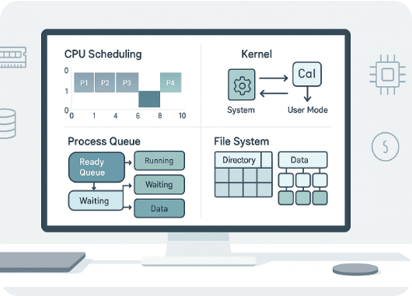
Chosen Algorithm: RMS
Rate Monotonic Scheduling (RMS)
Fixed Priority: Priorities are assigned statically based on task periods.
Frequency Rule: Tasks with shorter periods (faster frequency) get higher priority.
Preemptive: Higher priority tasks immediately interrupt lower ones.
Determinism: Perfect for periodic sensor reading in hardware systems.

Slide 3







Why Choose RMS for BMS?
Safety Critical
Predictability
Low Overhead
Critical tasks like Voltage Monitoring must run every 100ms. RMS guarantees they aren't blocked by slow background logging.
Using the Liu & Layland Bound, we can mathematically prove zero deadline misses before execution.
BMS requires simple, robust logic. RMS is easier to implement on microcontrollers compared to dynamic EDF scheduling.

Slide 4
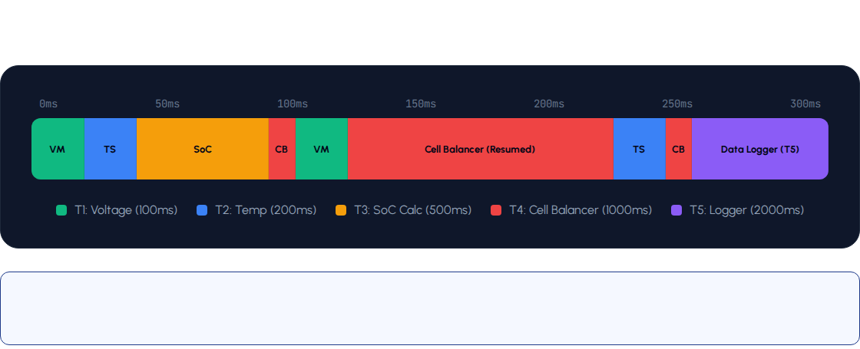
Single Gantt Chart (CPU Trace)
A unified execution timeline from 0ms to 300ms, showing exactly which task occupies the CPU at any instant.
Analysis: The Logger (T5) remains blocked until 250ms because all other processes have higher priority. Preemption is visible at 100ms when VM (T1) interrupts CB (T4).

Slide 5

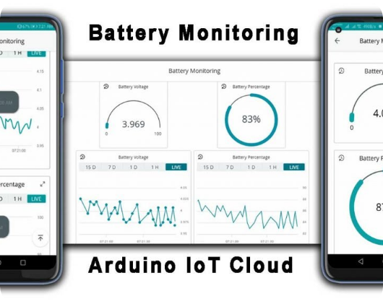


Performance Summary
55%
0
CPU UTILIZATION
DEADLINE MISSES
The simulation demonstrates that a Rate Monotonic Scheduler is highly effective for a BMS. By keeping utilization at 55% (well below the 69.3% theoretical limit), we ensure a safe buffer for hardware latency and unexpected tasks.

